Slide 1
ET4132 Database & Website Presentation
Ian Rowland
19190859

Slide 2
Overview of Chosen Business
Business chosen for this assignment was a small music school that aims to teach children the basics of Irish Music.
I chose this business idea because the service that the business would provide is something that interests me greatly, as a musician.
The web sites intended purpose is to serve as a means of applying for a place in the classes provided, as well as giving information about such classes.
The information held in the database is information about the classes held, the teachers giving the classes, the location of the classes, and the students attending the classes.

Slide 3
Database Overview
These represent the main entities in the database:
Students
M:1
Venues
Teachers
M:1
M:1

Slide 4
Database Overview
The entities can be related to each other through the class_info table
Student_info
venues
M:1
M:1
Class_info
1:1
teachers

Slide 5
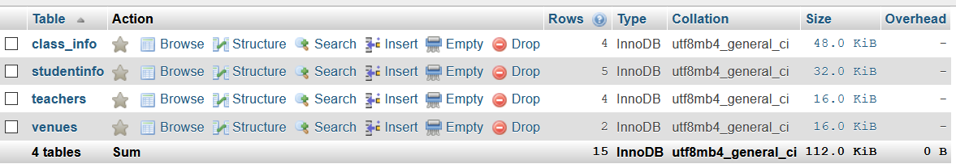
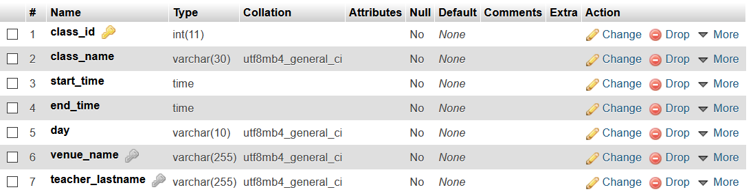
Database Overview

Slide 6
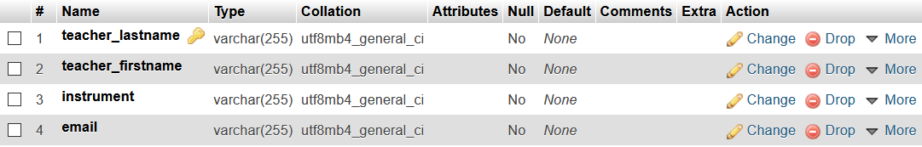
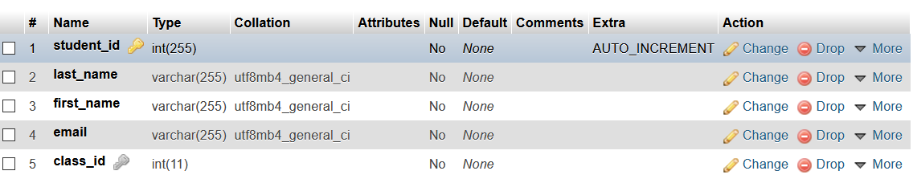
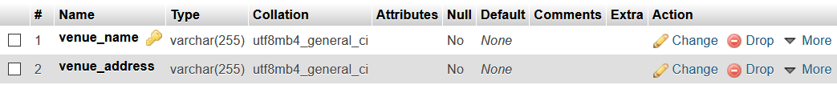
Database overview

Slide 7
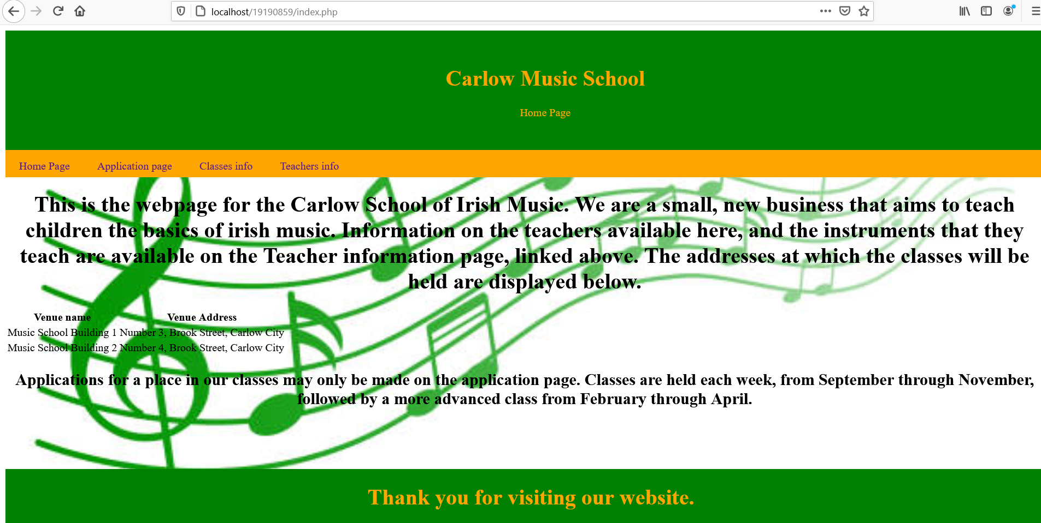
Website Overview
Home Page of the website. Also displays information from the databases venues table.

Slide 8
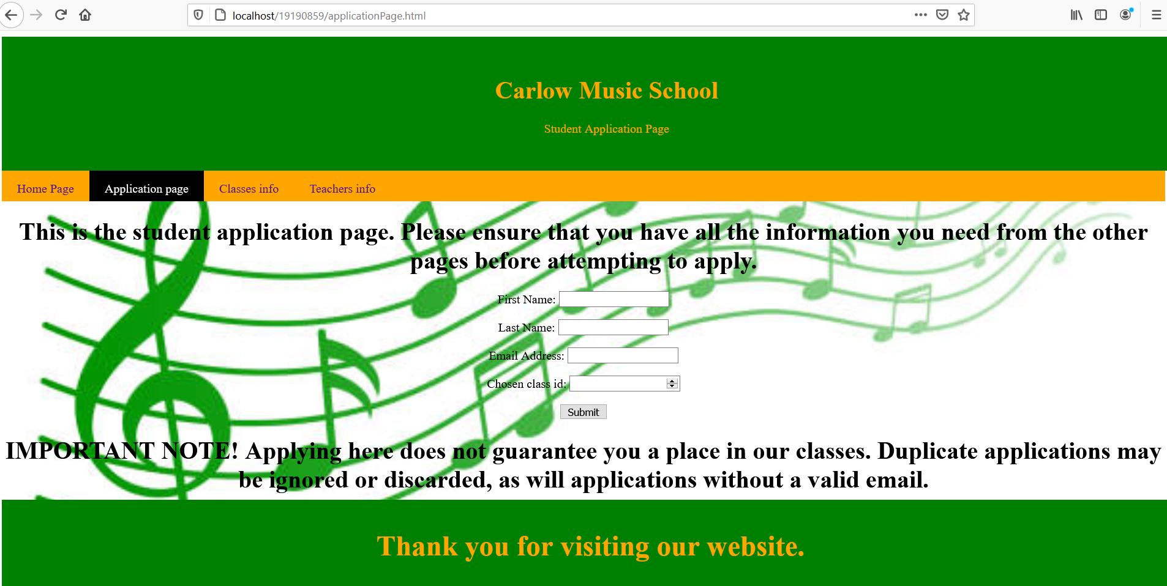
Website Overview
This is the Application page. It contains a form that, when the submit button is clicked, inserts the data entered to the forms into the student_info table.

Slide 9
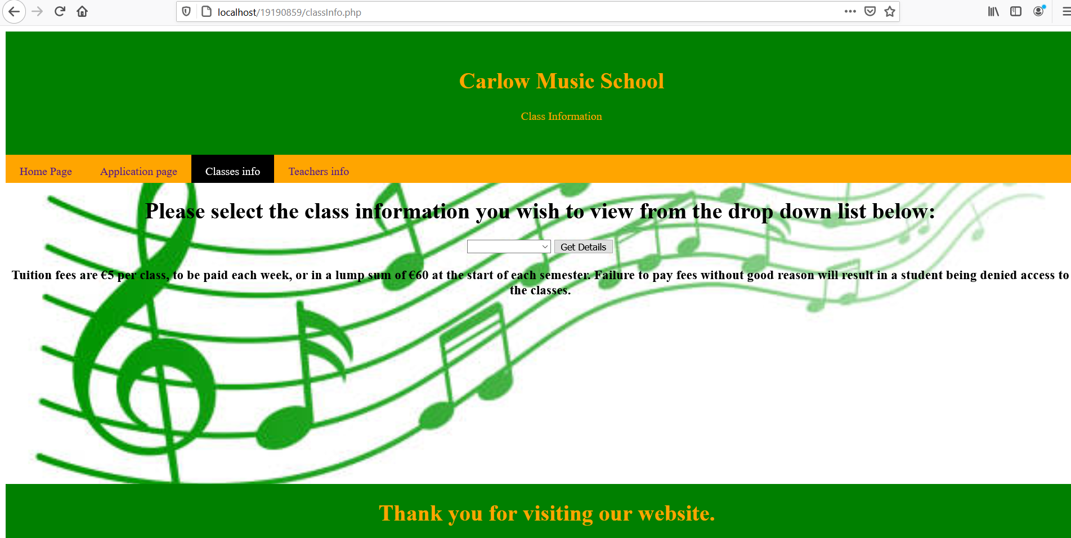
Website Overview
This page allows the user to access information on the classes available, by using the drop-down menu to select the appropriate class-name, and displaying the appropriate data from the database.

Slide 10

Website Overview
This is the teacher information page, which displays data from the database relevant to the teachers that provide each class.

Slide 11
PHP Overview
The following php code was used to display the venues table on the home page:
$sql = "SELECT * FROM venues;";
if(!$result = $conn->query($sql)) {
die( "There was an error running your SQL command<br />" );
}
echo "<table><tr><th>Venue name</th><th>Venue Address</th></tr>";
while( $row = $result->fetch_assoc() ) {
$venueName = $row["venue_name"];
$venueAddress = $row["venue_address"];
echo "<tr><td>$venueName</td><td>$venueAddress</td></tr>";
}
echo "</table>";

Slide 12
PHP Overview
PHP code for displaying user-selected data on the available classes:
if( isset( $_GET["class_id"] ) ) {
$id = $_GET["class_id"];
$sql = "SELECT * FROM class_info WHERE class_id = '$id';";
if( !$result = $conn->query($sql) ) {
die( "Unable to process your SQL command.<br />" );
}
echo "<table><tr><th>ID</th><th>Class name</th><th>Start time</th><th>End time</th><th>Day</th><th>Venue</th><th>Teacher(last name)</th></tr>";
while($row = $result->fetch_assoc()) {
$id = $row["class_id"];
$name = $row["class_name"];
$start = $row["start_time"];
$end = $row["end_time"];
$day = $row["day"];
$venue = $row["venue_name"];
$teacherName = $row["teacher_lastname"];
echo "<tr><td>$id</td><td>$name</td><td>$start</td><td>$end</td><td>$day</td><td>$venue</td><td>$teacherName</td></tr>";
}
echo "</table>";

Slide 13
PHP Overview
PHP for displaying the names of the classes to be selected in a drop-down list:
$formSQL = "SELECT class_id, class_name FROM class_info;";
if( !$result = $conn->query($formSQL) ) {
die( "Unable to process your SQL command.<br />" );
}
while($row = $result->fetch_assoc()) {
$id = $row["class_id"];
$name = $row["class_name"];
echo "<option value=\"$id\">$name </option>";
}

Slide 14
PHP Overview
PHP for displaying information on the teachers from the database:
$sql = "SELECT * FROM teachers;";
if(!$result = $conn->query($sql)) {
die( "There was an error running your SQL command<br />" );
}
echo "<table><tr><th>First name</th><th>Last Name</th><th>Instrument Taught</th><th>email</th></tr>";
while( $row = $result->fetch_assoc() ) {
$firstName = $row["teacher_firstname"];
$lastName = $row["teacher_lastname"];
$instrument = $row["instrument"];
$email = $row["email"];
echo "<tr><td>$firstName</td><td>$lastName</td><td>$instrument</td><td>$email</td></tr>";
}
echo "</table>";

Slide 15
PHP Overview
PHP for inserting the data taken from the application pages form, into the database:
$first_name = (mysqli_real_escape_string($conn, $_REQUEST['first_name']));
$last_name = mysqli_real_escape_string($conn, $_REQUEST['last_name']);
$email = mysqli_real_escape_string($conn, $_REQUEST['email']);
$classid = mysqli_real_escape_string($conn, $_REQUEST['classid']);
$sql = "INSERT INTO studentinfo (last_name, first_name, email, class_id) VALUES ('$last_name','$first_name','$email','$classid')";
if( !$result = $conn->query($sql) ) {
die( "Unable to process your SQL command, as it has either failed, or not yet attempted.<br />" );
}else{
echo "Application successfully completed.";
}

Slide 16
What Was Achieved
Overall, I feel that I completed everything I set out to achieve.
I had very little issue with the development of the database or the web-pages
I feel that the website would be very helpful to the business I have chosen for this assignment, for attracting would-be students.
Any Questions?

